Slide 1

Assignment 2
Search and Optimization
CS24M109 - Pashaula Eswar Sai
CS24M123 - Gooty Bharadwaj

Slide 2
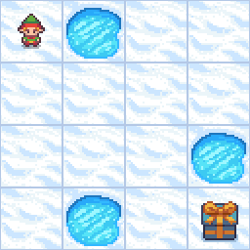
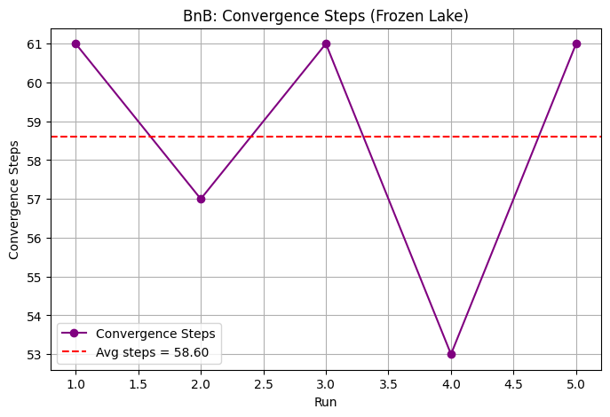
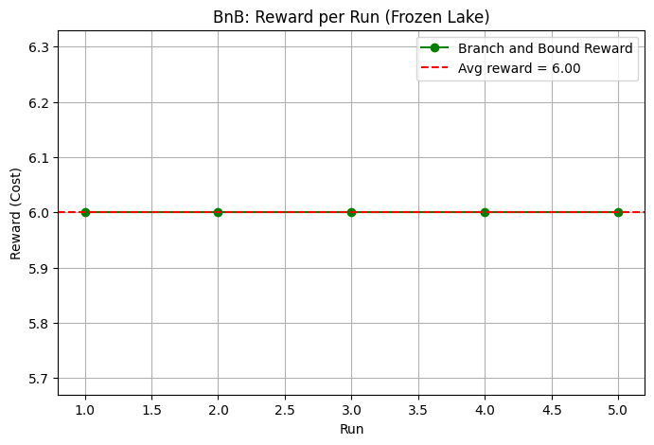
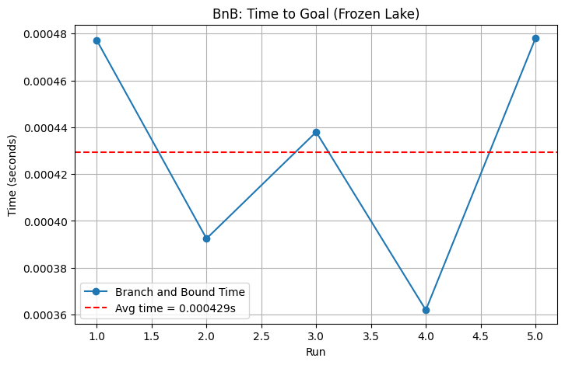
Branch and Bound

Slide 3

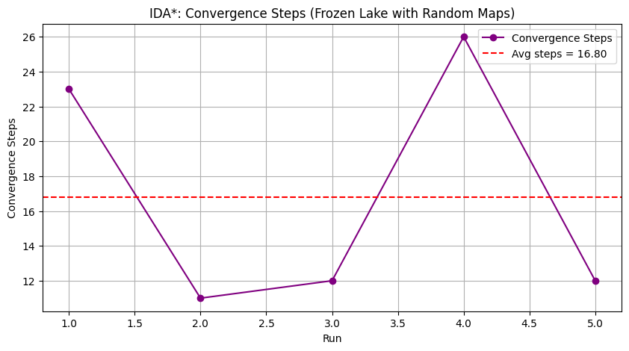
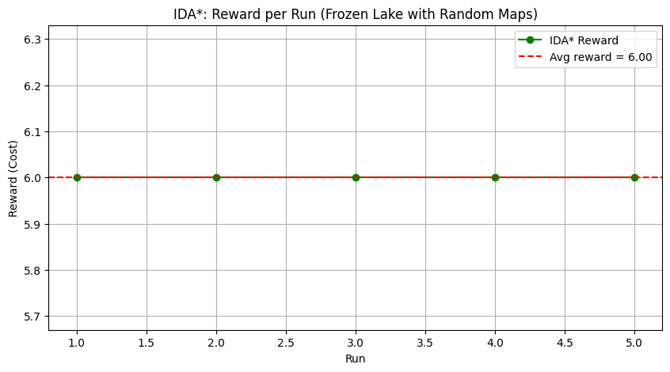
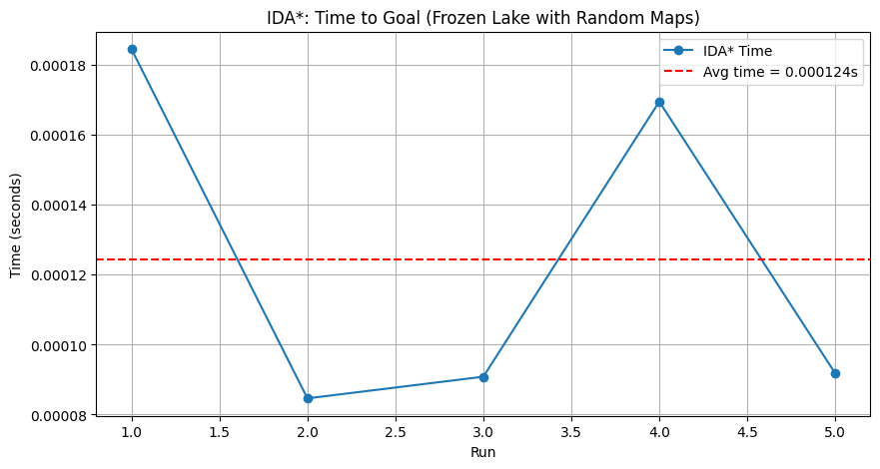
IDA*

Slide 4
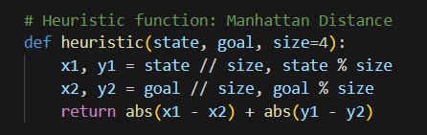
Heuristic Function
For BnB and IDA* the Manhattan distance:
For Hill Climbing and Simulated Annealing

Slide 5
Observations for BnB and IDA*
Both IDA* and BnB were run on Frozen Lake for a fixed start and goal point while changing the positions of obstacles in the path.
IDA* performed ~3.5x faster than BnB on average. This happens because IDA* leverages heuristic-guided along with depth limits pruning large parts of the search space early.
It avoids exploring full subtrees that exceed the thresholds.
BnB, while using cost-based pruning, still explores more suboptimal branches before updating the best path.
Both algorithms are complete and optimal for the frozen lake problem.
IDA* is better suited for Frozen Lake compared to BnB. BnB has overhead in terms of recursion and storage because of keeping track of visited states and costs
Both algorithms found optimal solutions in all runs (Cost=6)

Slide 6
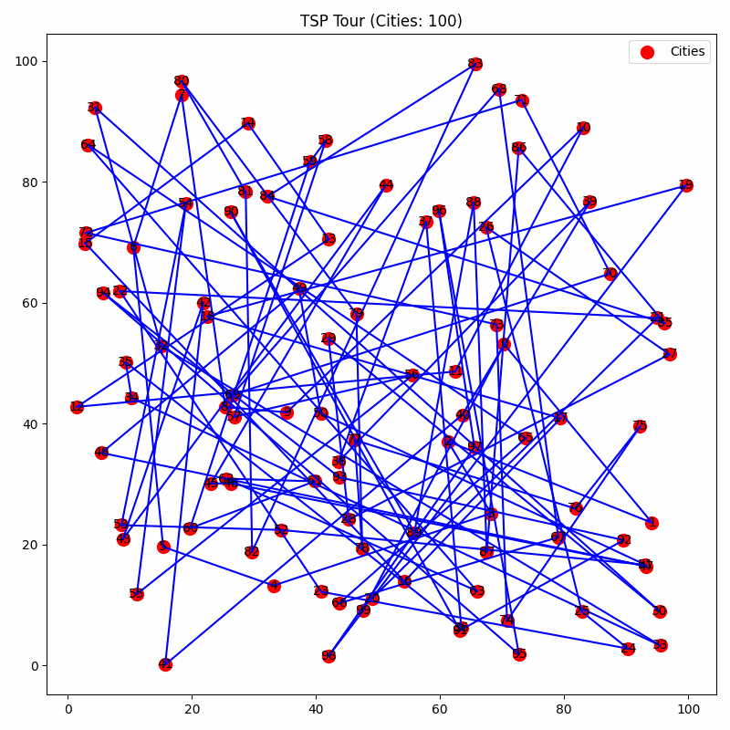
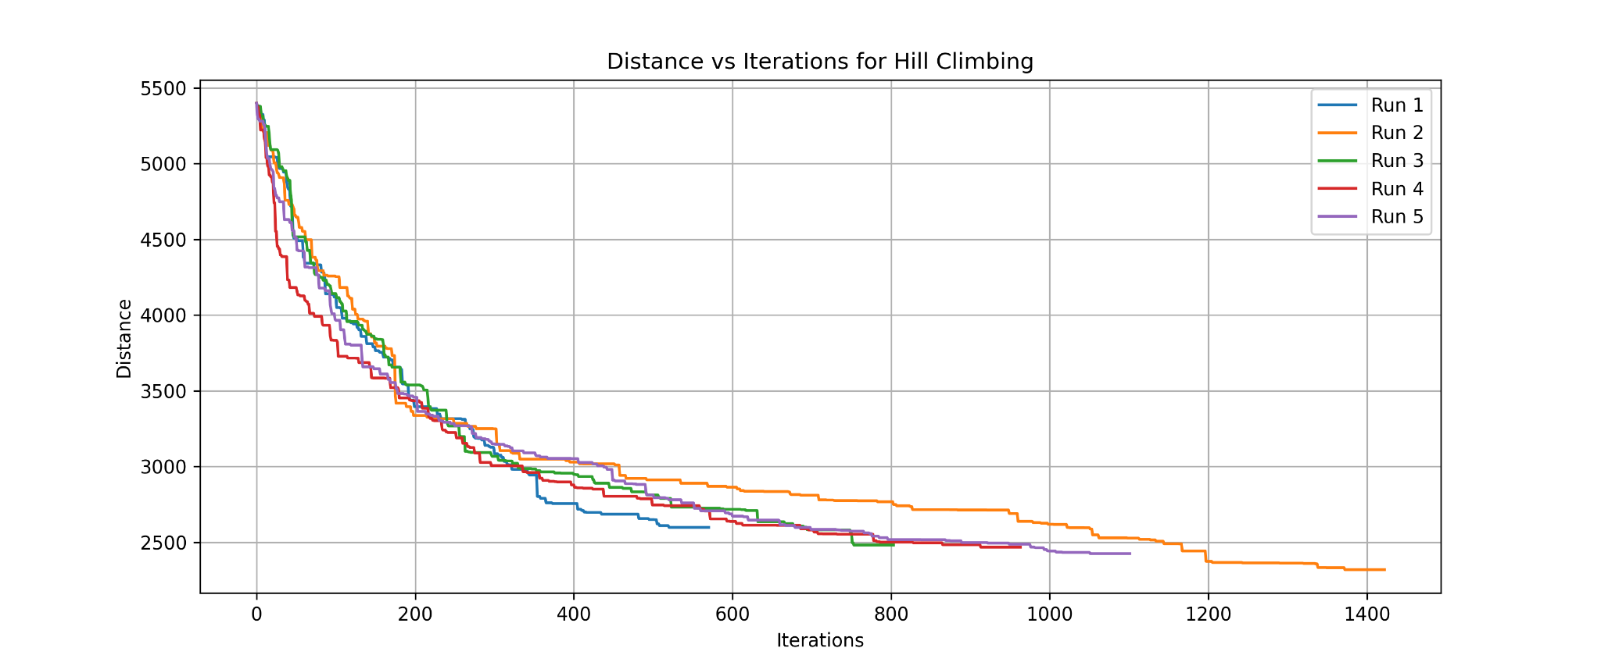
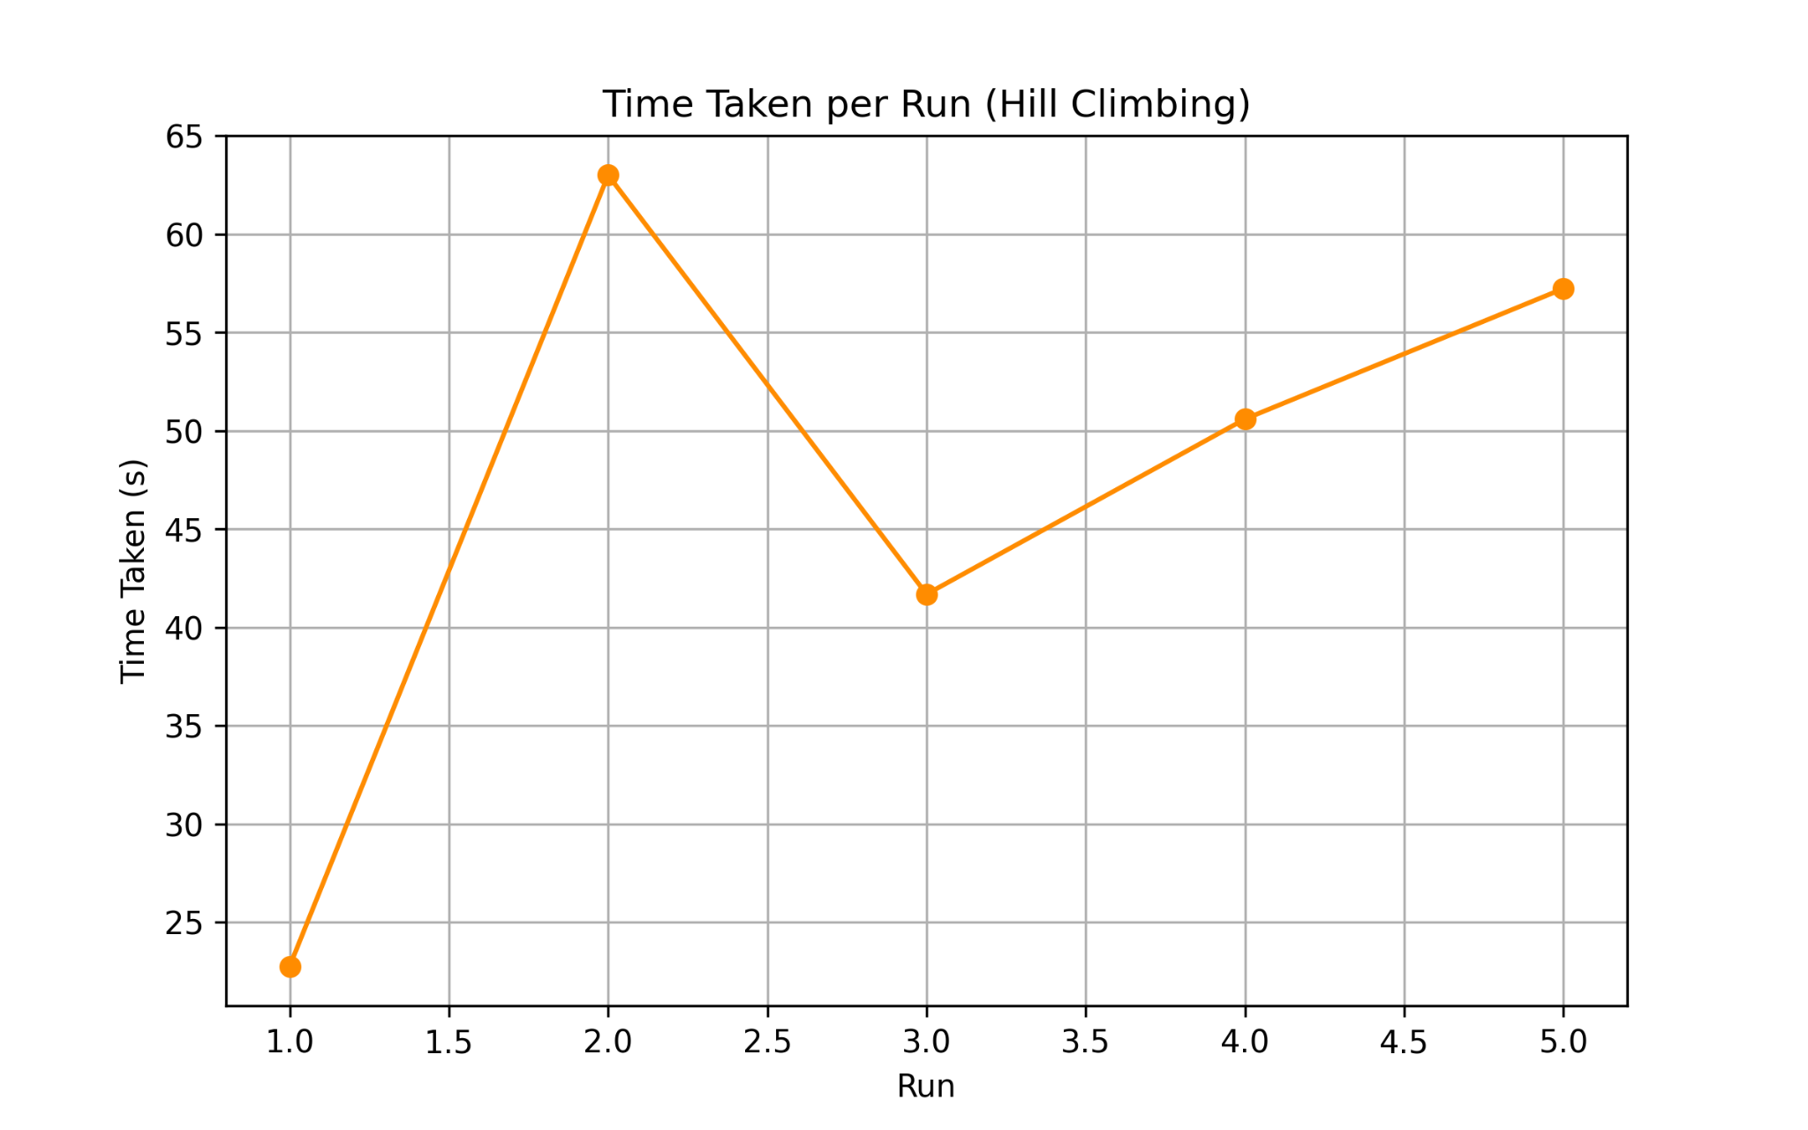
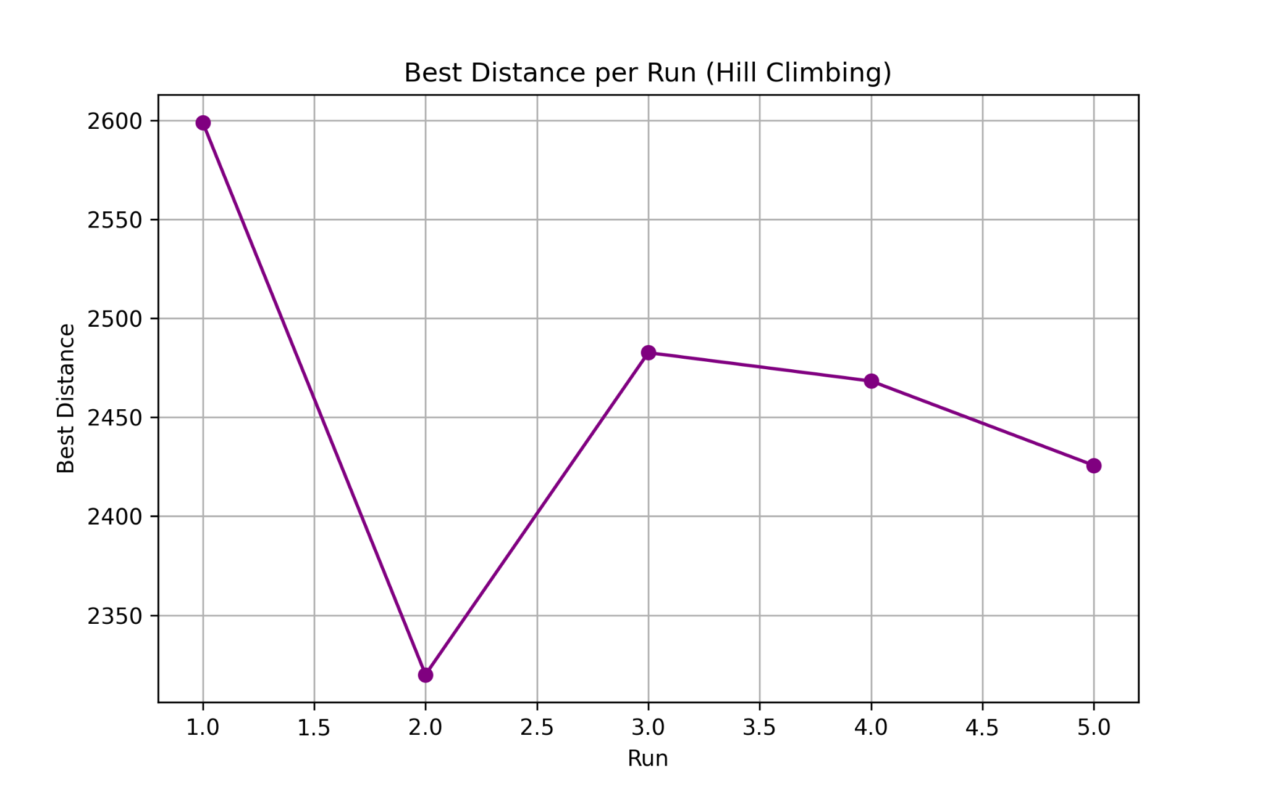
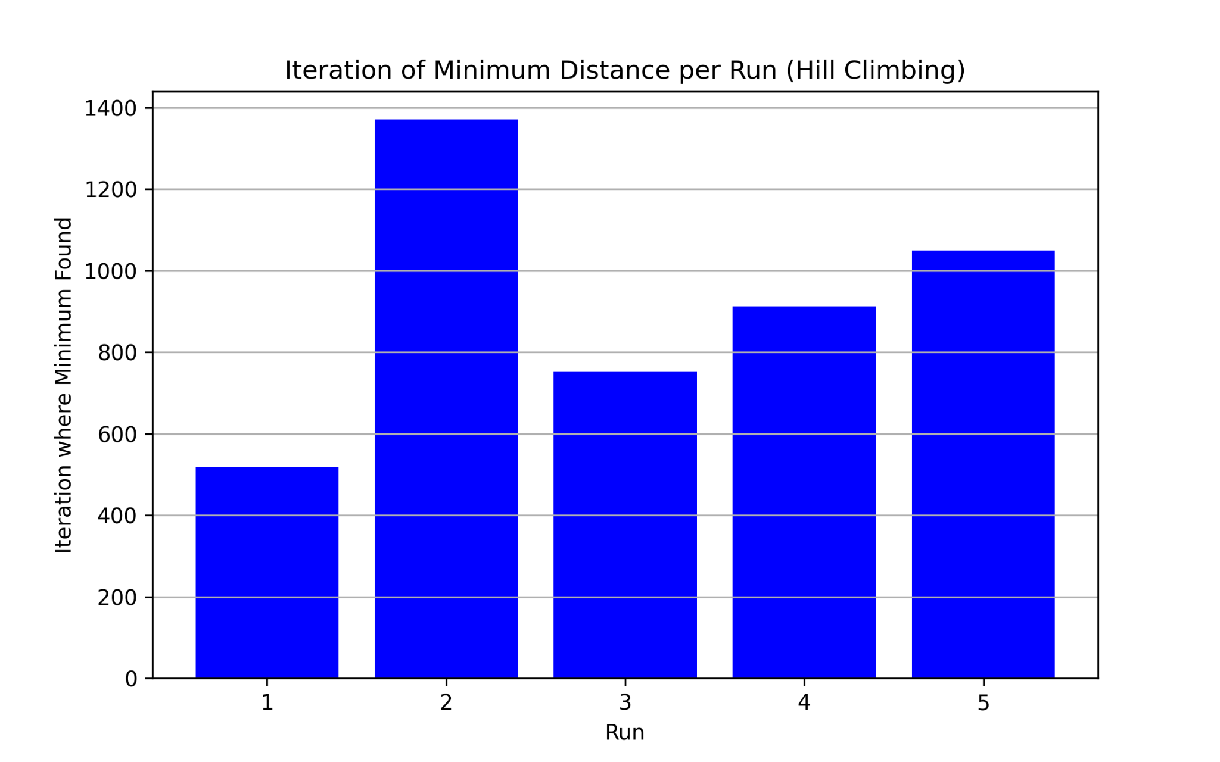
Hill Climbing for
Travelling Salesman
Consistent downward trend – Hill climbing always chooses better solutions, leading to steady improvement.
No sudden jumps – Only better neighbors are accepted, so there are no sharp distance drops.
Early improvements – Most of the improvement happens in the initial iterations when better neighbors are abundant.
Plateaus/stagnation – Some runs get stuck in local minima, leading to flat lines (no improvement).
Different end values – The final distance varies due to different starting points and local optima.

Slide 7
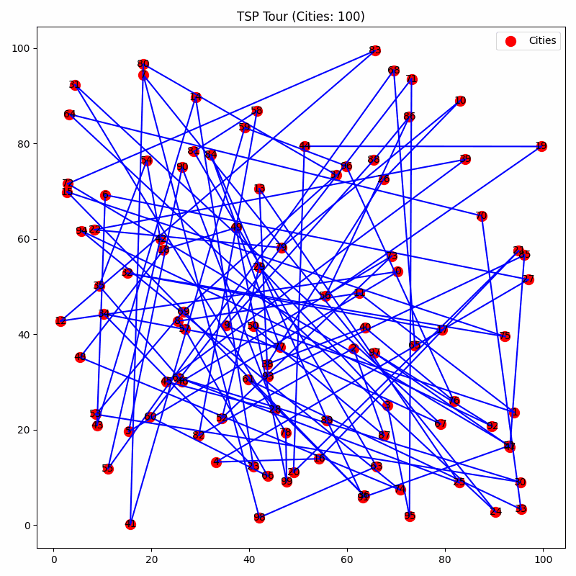
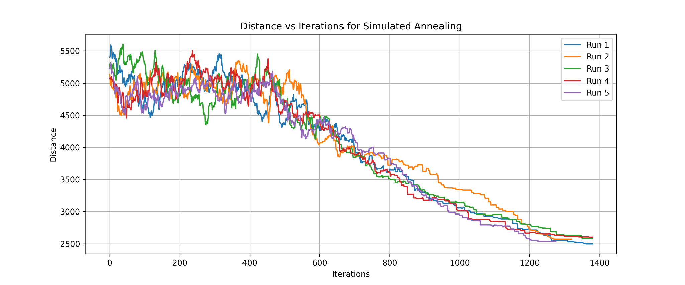
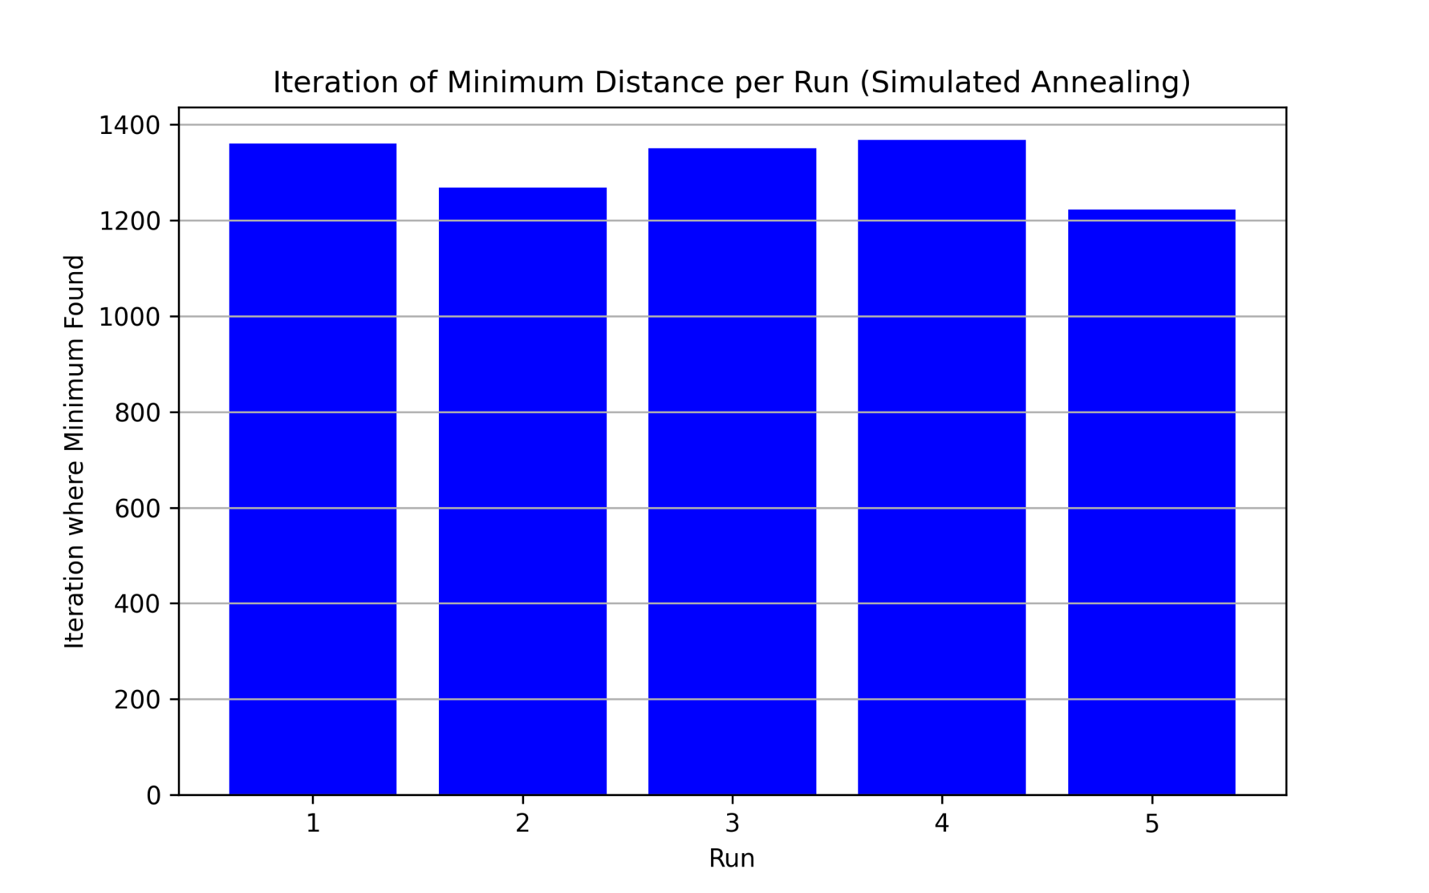
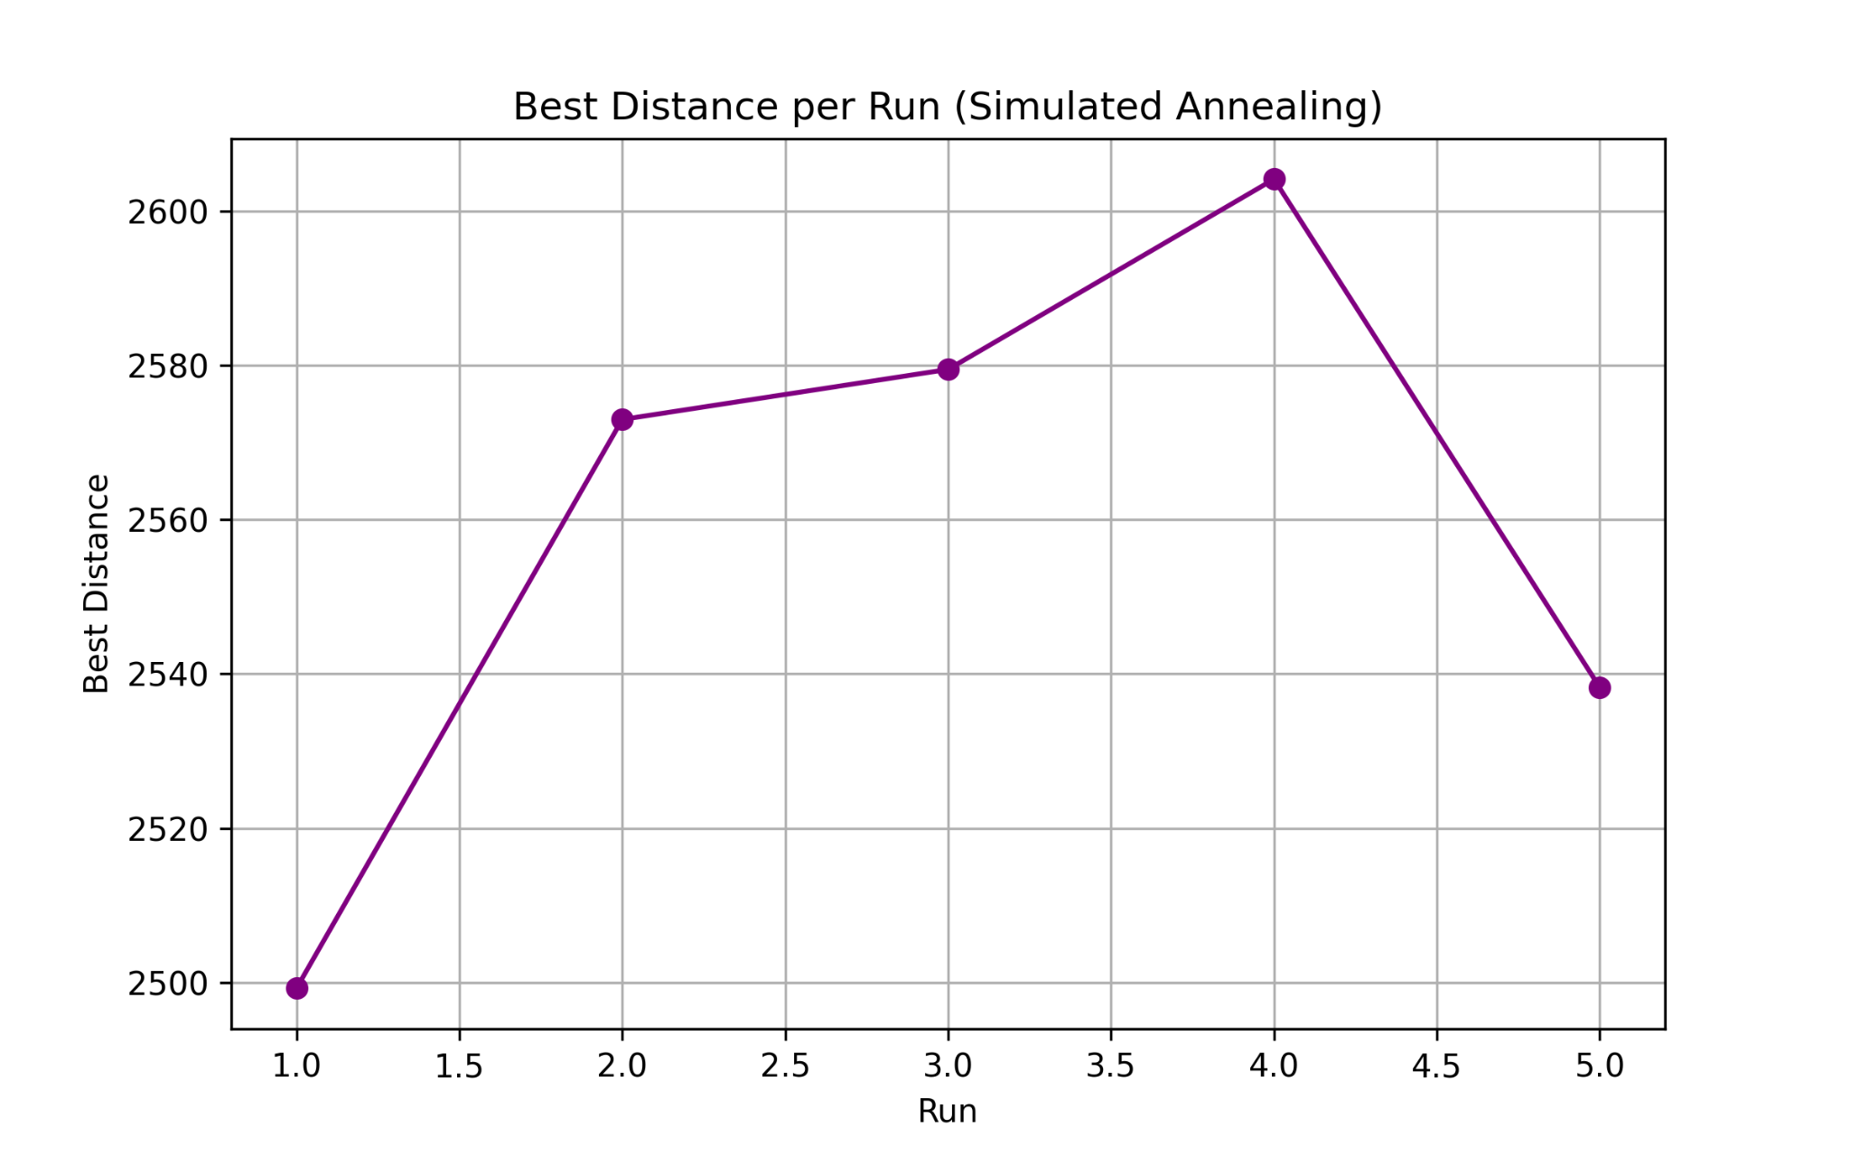
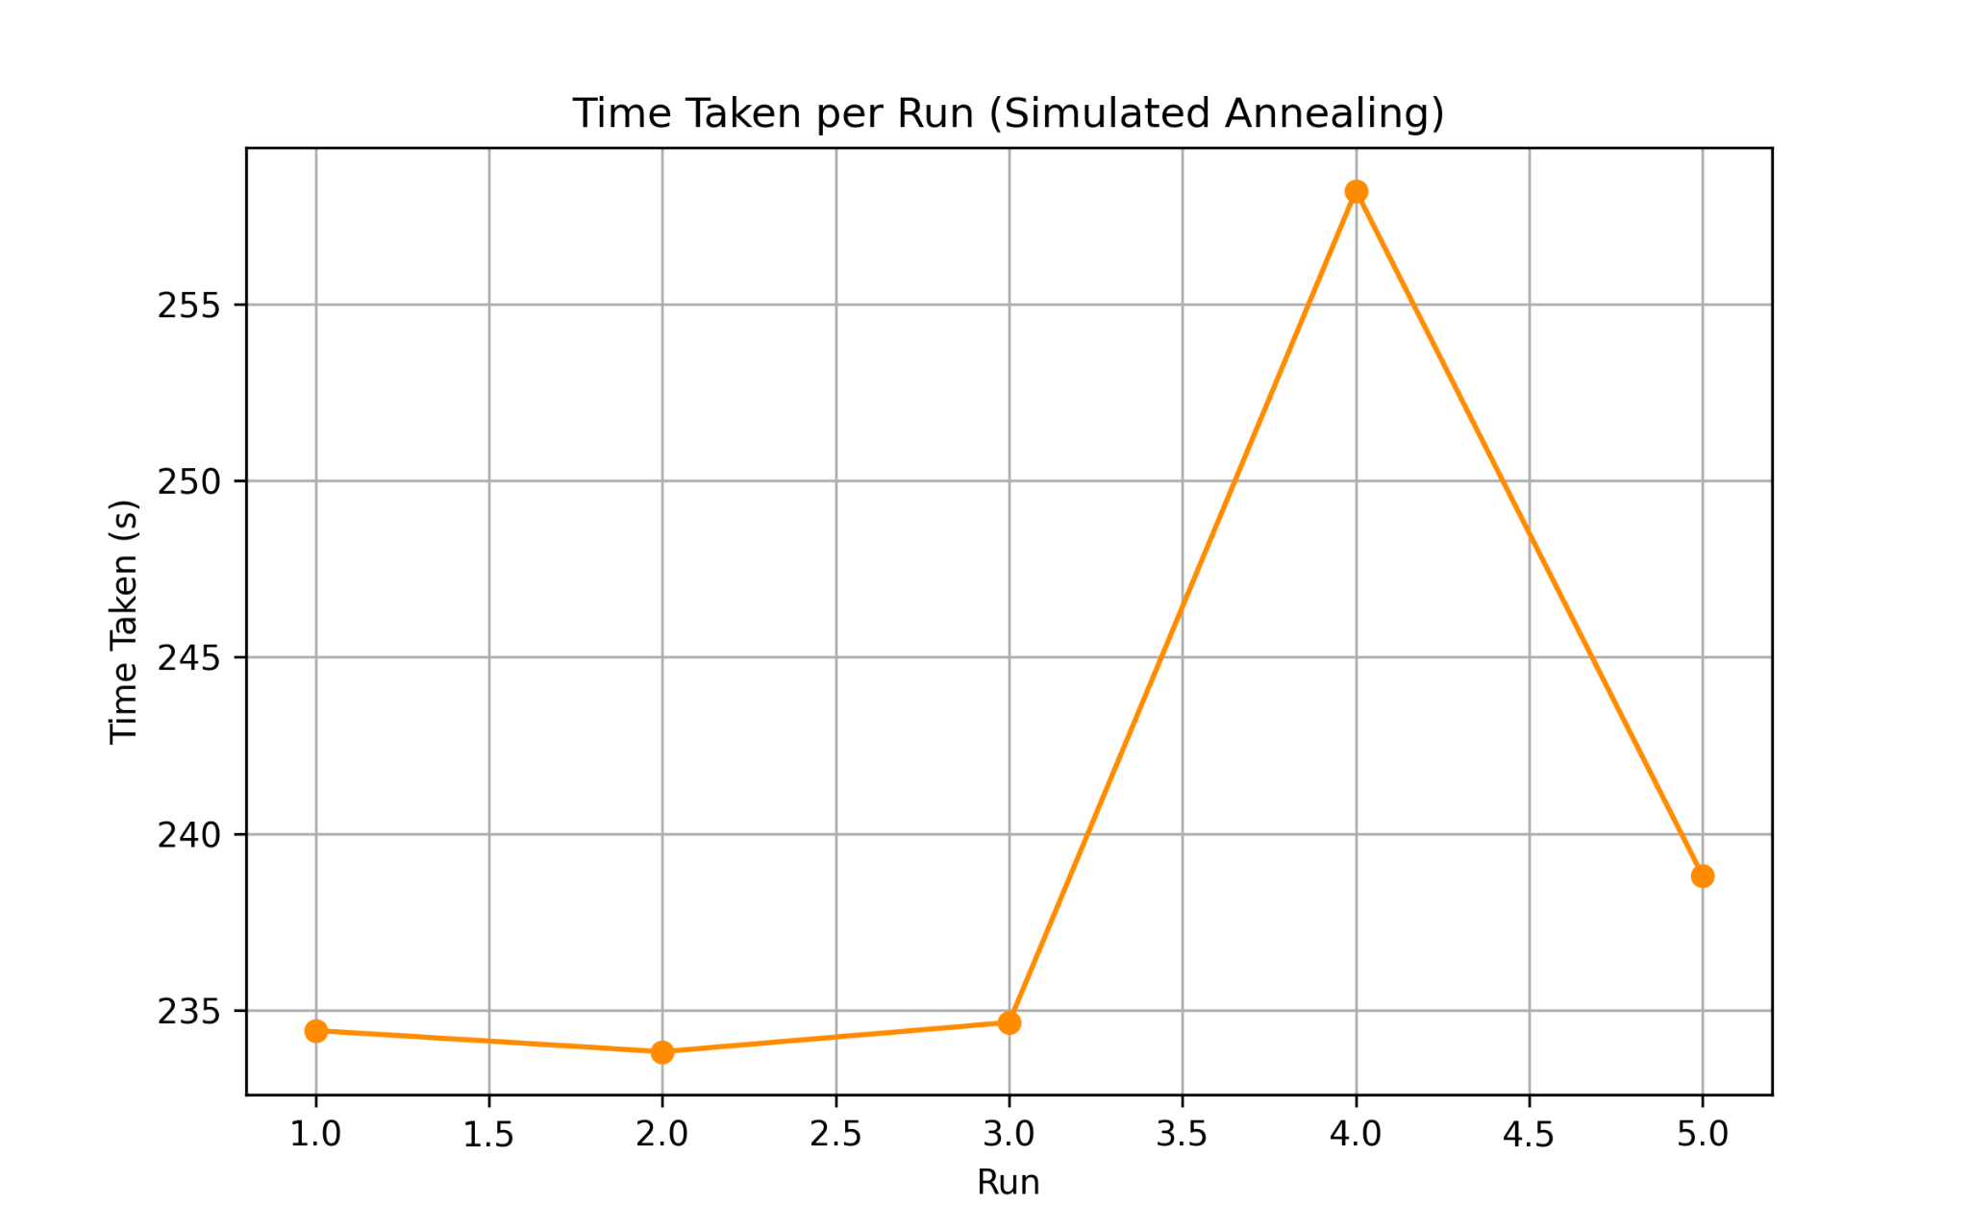
Simulated Annealing
High fluctuations early – Simulated annealing accepts worse solutions at high temperatures to escape local minima.
Smoother drop later – As the temperature decreases, it becomes more selective, accepting only better or similar solutions.
Sudden drops – Occasionally, a significantly better solution is found, leading to sharp improvements.
Different early paths – Random initial solutions cause each run to explore a different trajectory at the beginning.
Similar final values – Despite randomness, the algorithm converges towards a near-optimal solution in all runs.

